Slide 1

Predicting Customer Behavior Phase 3
Jarrod Lott
UMBC
DAT 606
Fall 2020

Slide 2

Overview
Project Refresher
Decision Tree Recap
KNN
Naïve Bayes
Random Forest
Summary

Slide 3
Project Refresher
Topic
Predict customer behavior for banking customers

Slide 4
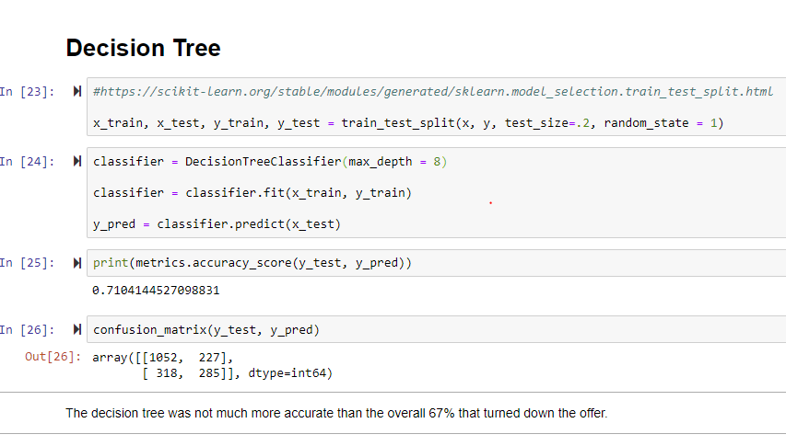
Model
Decision Tree
67.54% declined offer
71.04% accuracy
3.5% improvement

Slide 5
New Steps
New Algorithms Tested
KNN
Naïve Bayes
Random Forest

Slide 6
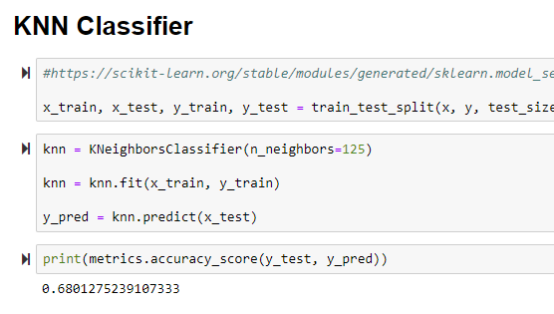
Model
K Nearest Neighbor
67.54% declined offer
68.12% accuracy
.47% improvement
Findings
Adjusting the number of neighbors had more impact than the attributes used

Slide 7
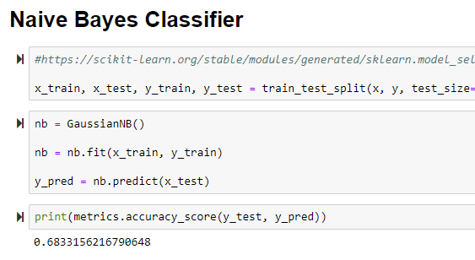
Model
Naïve Bayes
67.54% declined offer
68.33% accuracy
.79% improvement
Findings
Adjustments in attributes used did not improve the model

Slide 8
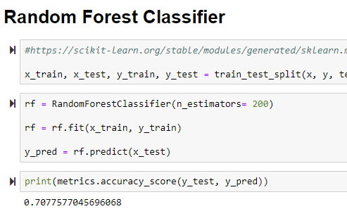
Model
Random Forest
67.54% declined offer
70.78% accuracy
3.23% improvement
Findings
Removing attributes hurt performance
Adjusting estimators improved performance

Slide 9
Results
Ranking of Algorithms
Decision Tree 3.5%
Random Forest 3.23%
Naïve Bayes .79%
KNN .47%

Slide 10
What Next?
Adjust Dataset
Adjust the declined offers to 50% and run testing again
Gather More Data
Test other attributes to see if they can be added to the existing data set and produce an even more accurate prediction

Slide 11
Review
Project Refresher
Decision Tree Recap
KNN
Naïve Bayes
Random Forest
Summary

